Slide 1
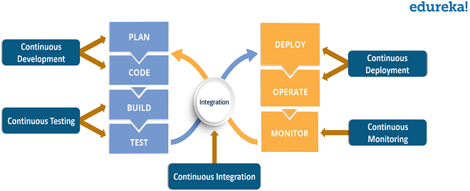
DEVOPS LIFECYCLE

Slide 2
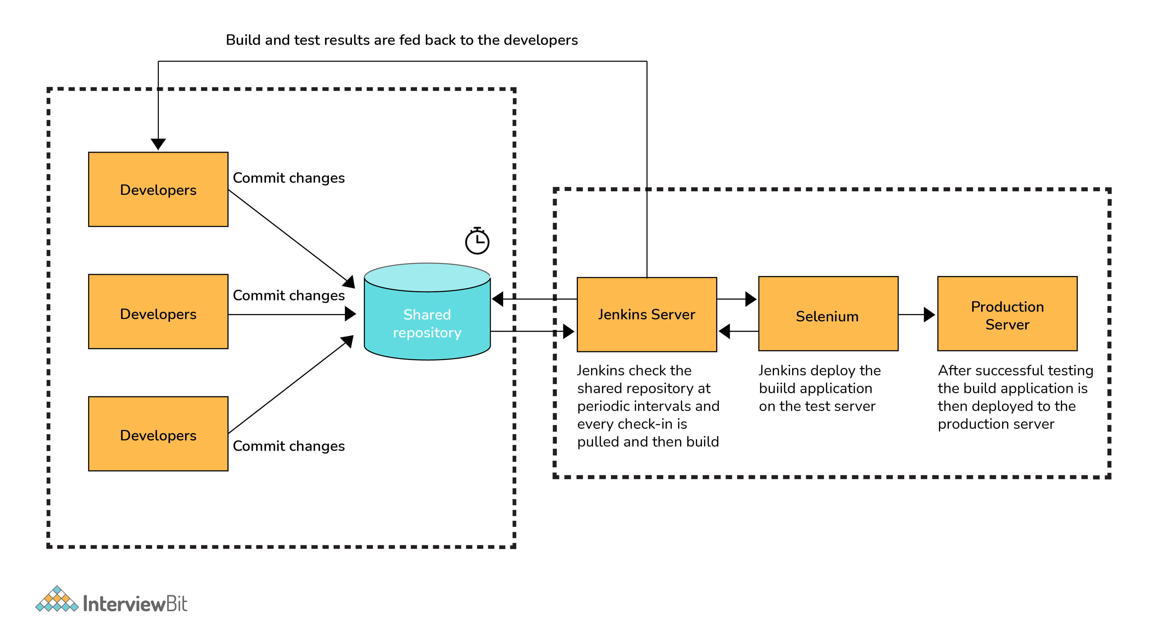

Slide 3
AGILE METHOLODY
Agile offers a more flexible, iterative approach that features shorter cycles. With Agile, the focus is on lean development and creating MVPs or minimum viable products over specific durations, while delivering improvements with every new software iteration.

Slide 4
WATER FALL METHOD
The Waterfall model is regarded as the traditional software development strategy where the project is divided into unique stages or events that have to be completed sequentially. With this non-iterative design process, the software isn’t ready for release until after it has linearly passed through all the stages.

Slide 5
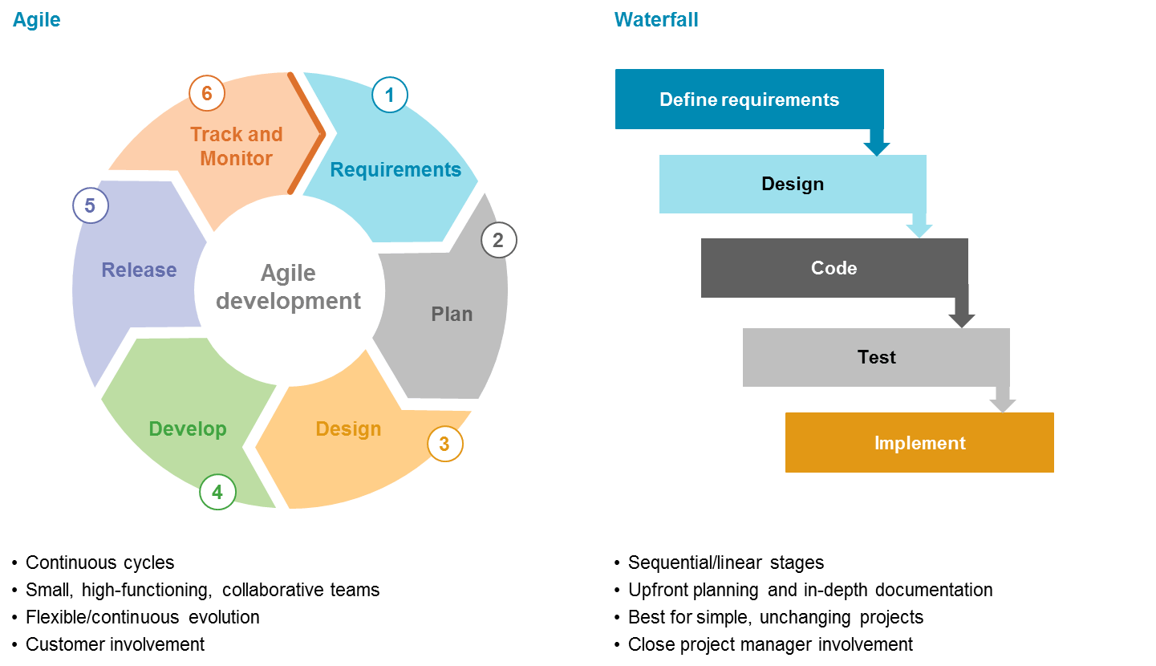

Slide 6
SCRUM METHODLOGY
Scrum is an agile way to manage work. Ever few weeks (typically two to four), teams deliver a fully functional chunk of work (an increment). Teams and the business use the feedback from each delivery to determine what to build next, or how to adapt what they've already built.

Slide 7
